Slide 1

Bank Loan Case Study
By Sheetal Sule

Slide 2




Project Description
In this project, we're looking at how to make better loan decisions for our finance company that focuses on all the loan applicants.
We have some customers who can't pay back their loans on time, especially those without much credit history.
We'll dig into our loan data to find out which factors make a customer more likely to miss their payments.
We also want to understand why some loan applications are rejected or go unused, even after approval.
By the end of this project, we hope to have clear ideas on how to reduce bad loans and ensure we're not missing out on good opportunities.

Slide 3


Tech Stack Used
I have used excel for all the statistics part and generated graphs to represent those insights better.
I used Microsoft PowerPoint to generate this presentation.

Slide 4
Approach
I have used Excel to do all the data cleaning using excels sort, filter and basic functions to remove the null values and duplicates.
I also used conditional formatting and descriptive statistics to calculate interquartile range and find the outliers.
I have used various graphs to represent the insights better.
Link - https://docs.google.com/spreadsheets/d/1mnUmoh7mbG_8IRc3jat2Ie0aOp3adi7h/edit?usp=drive_link&ouid=107126857418427123288&rtpof=true&sd=true

Slide 5
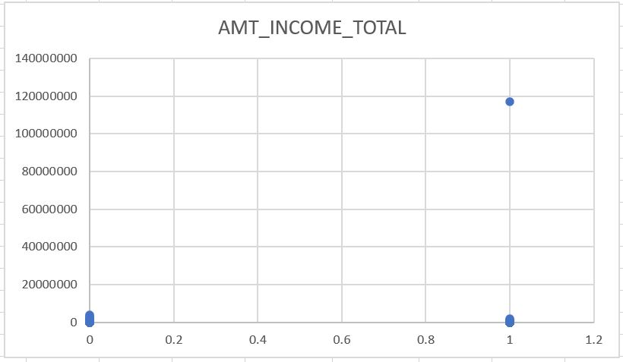
Outlier -1
In this chart, we notice that some people are making around 11 crores, which is way more than most applicants who earn in lakhs.
This unusually high income is also skewing our analysis and this indicates that it needs our special attention resulting as a major Outlier

Slide 6
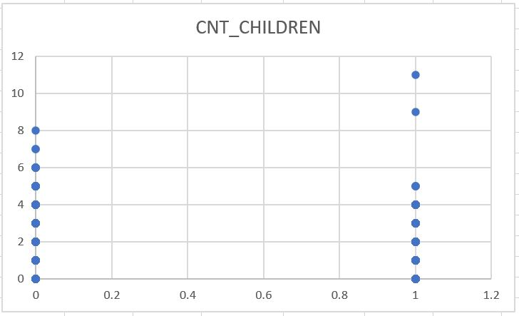
Outlier -2
This chart shows some unusual data for families with kids.
For those who are not the making payments on time, some have up to 19 children, which is pretty rare nowadays.
For those who are making payments on time, some have more than 7 children.
Both of these cases stand out and could significantly impact our analysis.

Slide 7
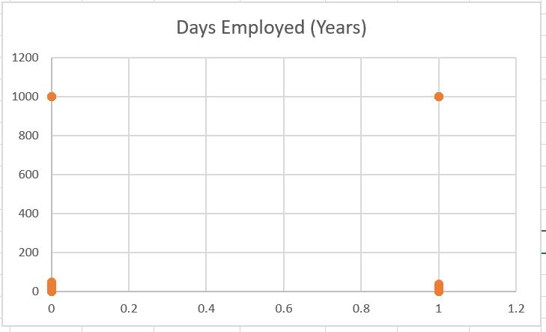
Outlier - 3
This chart on employment days has some odd data points.
It shows some people have been employed for 1000 years from the day they applied for a loan, which is obviously incorrect and throws off our analysis completely.

Slide 8
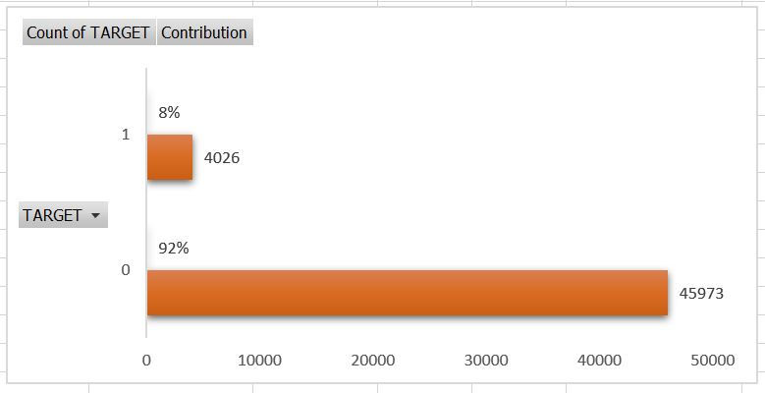
Data Imbalance
This chart shows that out of 50000 loan applications, 92% were paid on time while 8% had payment issues.
The ratio of people with payment problems to those without is 11.39.
This is an uneven distribution, where there are way more people paying on time compared to those who aren't, could really impact how we understand and analyze this data.

Slide 9
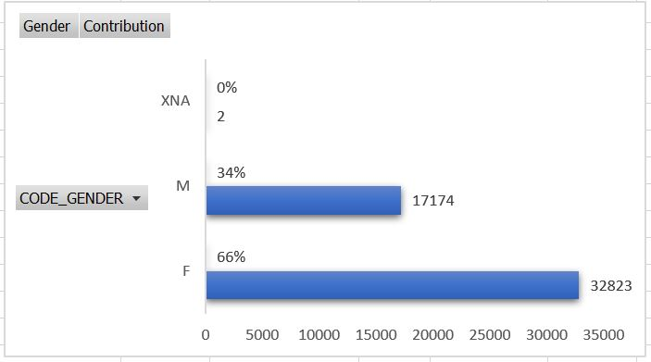
Data Imbalance
This chart shows a gender gap among loan applicants.
So basically It highlights how men and women differ in their roles in business and investments.
This also could affect our analysis and should be taken into account.

Slide 10
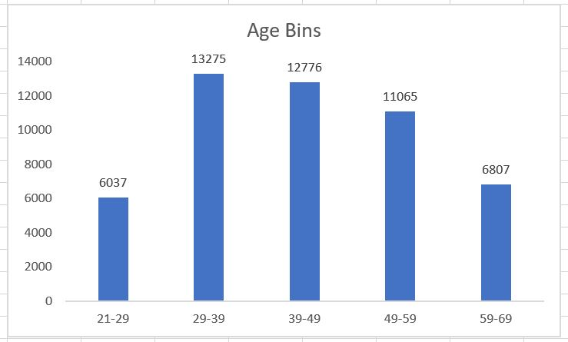
Univariate Analysis
Univariate Analysis defines as the analysis of data that contains only one variable.
This chart shows univariate analysis which is the Age bins we have created from BIRTH_DAYS(YEARS)attribute column.
Majority of the applicants were offered loans in the Age range from 29 to 59.

Slide 11
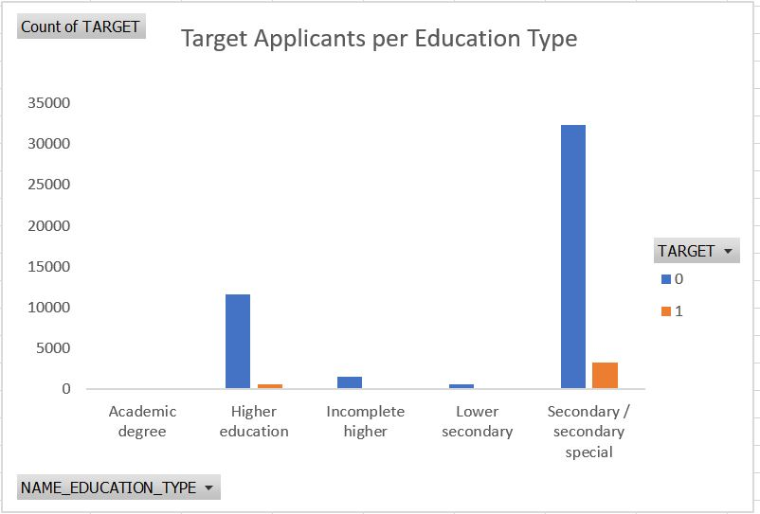
Segmented Univariate Analysis
This chart breaks down applicants into two groups based on whether they have payment difficulties or not.
It then shows how many people in each group fall into different Education Types.
This chart reveals that the people with Higher education and Secondary Special education are making their payments on time.
Which can help us in our loan offerings and improvement in the risk factor.

Slide 12
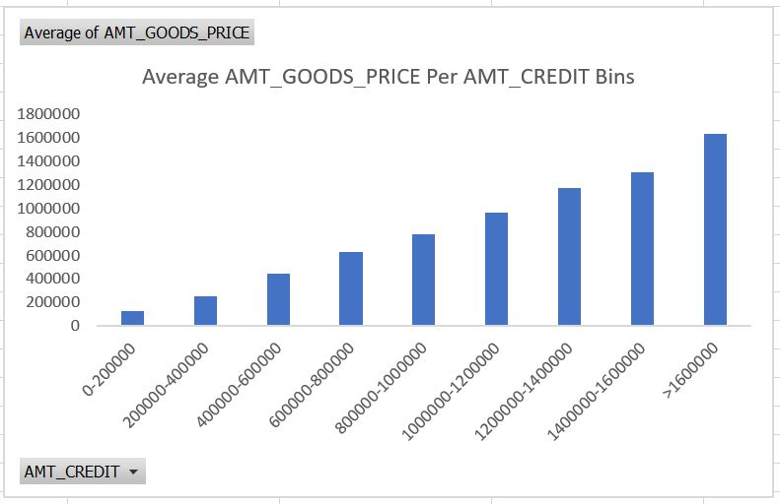
Bivariate Analysis
Bivariate analysis is one of the statistical analysis where two variables are observed.
One variable here is dependent while the other is independent.
We are observing two variables here which is amount credit and Amt goods price.
This chart looks at two things - how much Amount credit people get and how big the amount of goods price they have.
It shows that people who get more amount Credited generally have bigger amount of goods price.

Slide 13
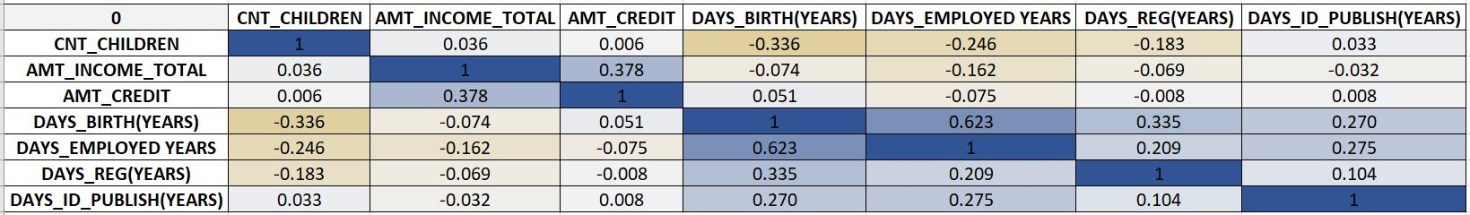
Correlations For Applicants With Payment Made On Time
The above chart uses colors to show how closely different factors are related to each other which is for people who pay the amount on time.
In this heat map Blue color shows the factors are strongly linked, and yellow color shows they're not closely related at all.
Choosing the attributes with low correlation with each other can help us to reduce the risk factor while approving loan applications.

Slide 14
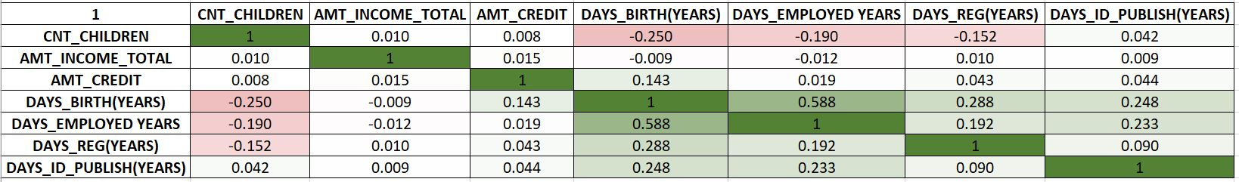
Correlations For Applicants With Payment Difficulties
The chart uses green and red colors to show the correlation which is how different factors relate to each other for people who doesn't pay their loans on time. Green means these factors are strongly connected, while red means they're not really related to each other.
This correlation not only helps with identifying the relationship between the these variables, but also shows how if one data set changes, it will have an effect on the other data set and that will help us to make better decision in our business.

Slide 15
Thank You!

